Slide 1
WELCOME TO OPEN HOUSE

Slide 2
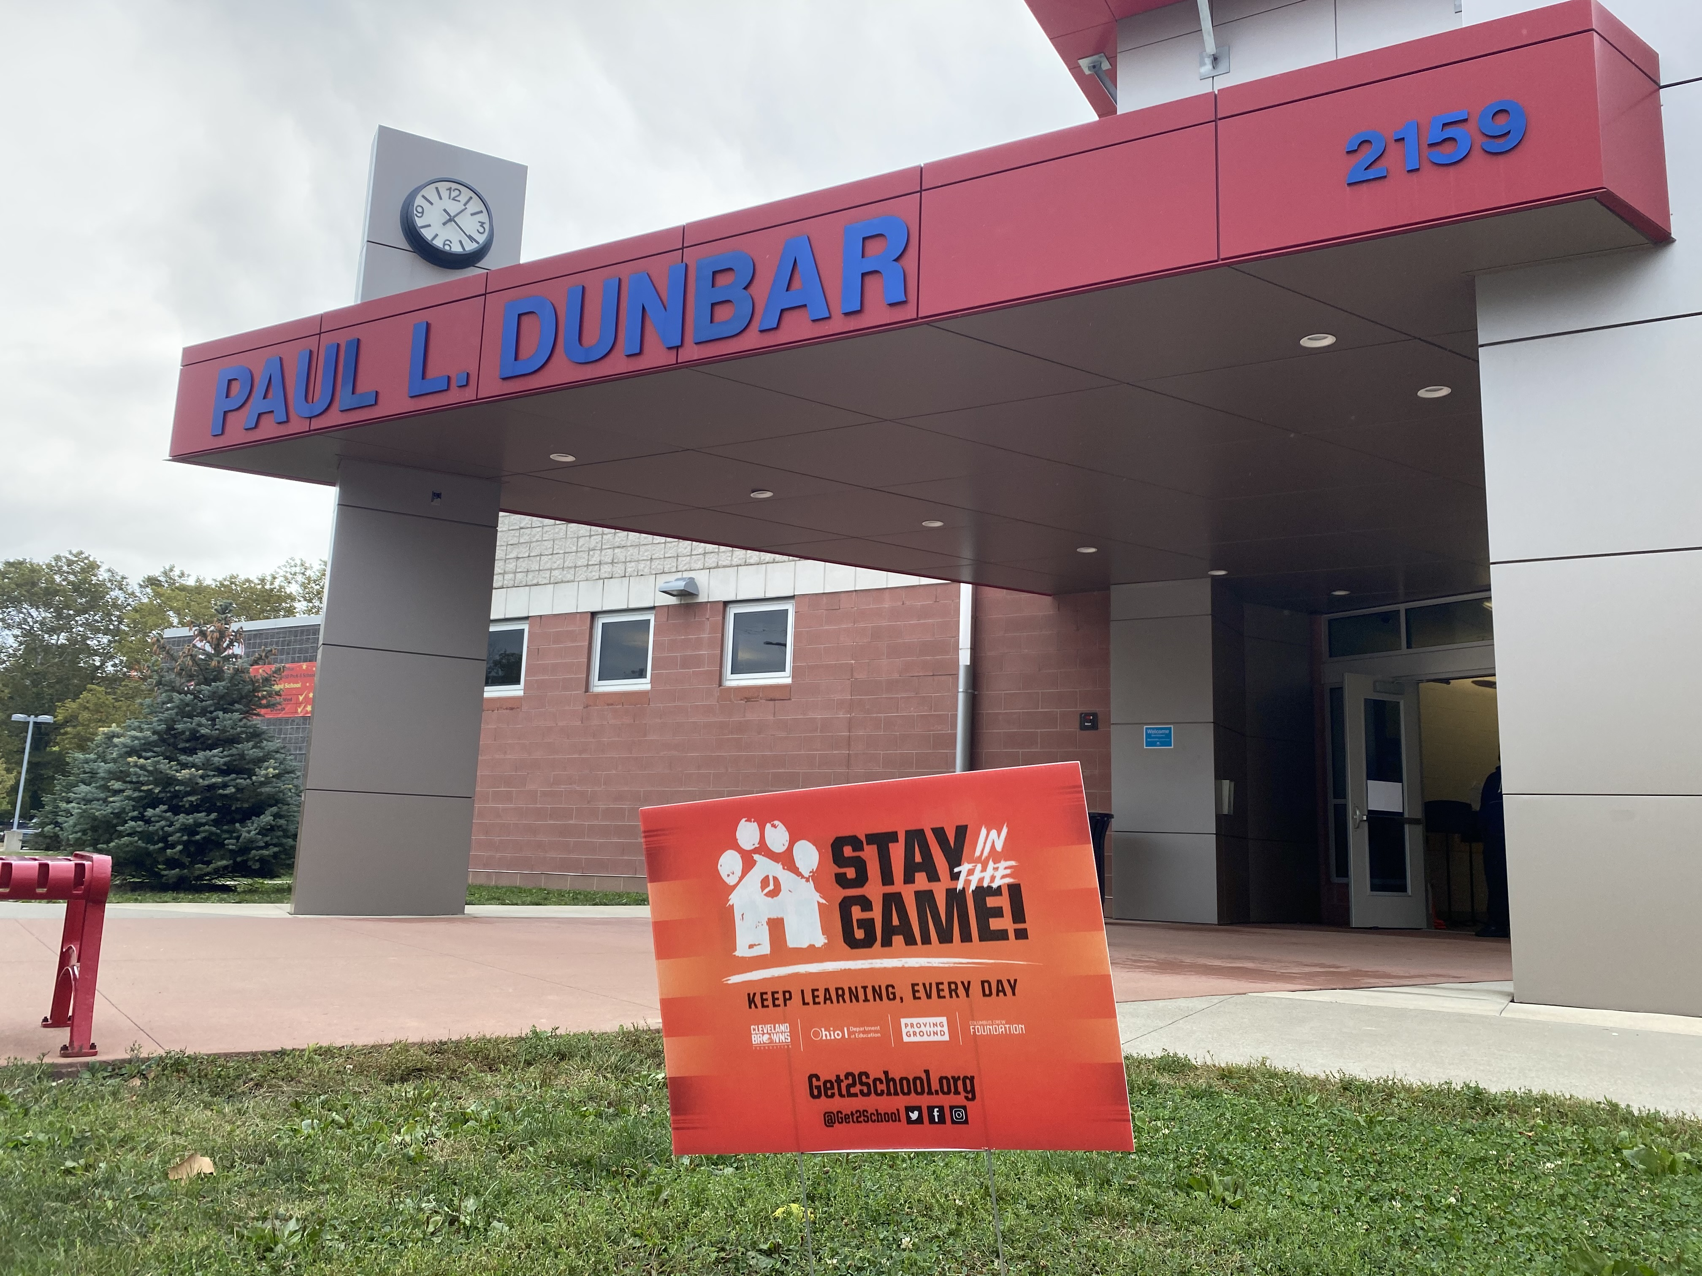

Paul L. Dunbar Arts Enrichment Academy
School
216-838-7400​

Slide 3
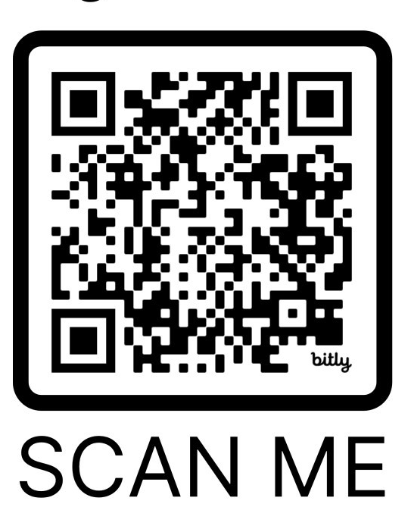
Family Engagement Universal Sign-in QR Code

Slide 4
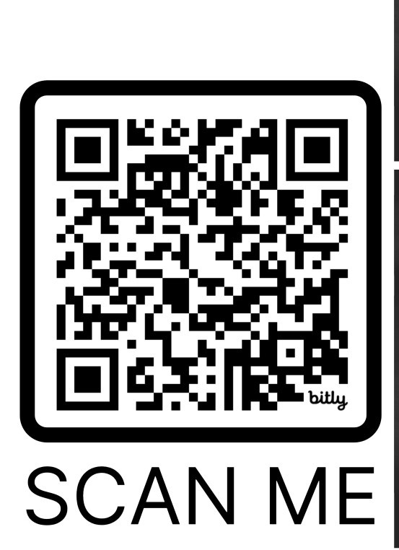
Title 1 Open House Survey

Slide 5
School Vision and Goals
CMSD Vision
In our pursuit of a more fair, just and good system of education, we want each of our learners, both each of our scholars and each of their educators, to be individually and collectively presented with academically/intellectually complex tasks that are worthy of their productive struggle and allow them authentic opportunities to demonstrate their work and their learning of academic content and transferable skills in a joyful and adventurous environment.
Paul L. Dunbar Arts Enrichment Academy
Mission
Our mission is to provide children with learning experiences through an integrated arts curriculum that will empower them to develop critical and creative thinking skills as they become productive members of society. We encourage academic, technological, artistic, and social emotional growth while scholars work, study, serve, and lead themselves and others to personal greatness

Slide 6
Open House Agenda
6:00-6:30: Welcome / General Session
6:30-8:00: Meeting with Teachers
Be sure to check out our tables/clubs for information on:
RAFFLE! 2 DRAWINGS
Bake sale
Shirt Orders
Say Yes
6-8 grade Athletics Table
6-8 grade Good 2 Great –character development course
Piano Cleveland and Cleveland Jazz Orchestra Sign Up

Slide 7
New this year
High Quality Instructional Materials across every school, classroom and grade
English Language Arts curriculum
Electronic Gradebook
MyPowerHub parent access portal
Cell-phone-free learning environments

Slide 8
Academic Achievement Plan
Each year we develop an Academic Achievement Plan for our school based on student achievement.
•These are our priorities for this year
•–Reading Proficiency
•–Math Proficiency
•–PBIS- Positive Behavior Intervention System

Slide 9
 | 23-24 District Proficiency | 23-24 Dunbar Proficiency | 24-25 Goal
OST ELA | 27% | 32% | 42%
OST MATH | 20% | 63% | 71%

Slide 10
Academic Achievement Plan ELA Focus
New HMH Curriculum K-8 –that aligns with the Science of Reading
Structured Literacy for K-3
Small group instruction
Direct instruction, modeling, guided practice, feedback, and independent practice.

Slide 11
High Quality Instruction Materials
In support of our Strategic Priority, A Strong and Engaging Instructional Core:
All schools will implement a new ELA curriculum this year in all K-12 classrooms.
Our new curriculum was adopted this year with input from teachers, administrators, and families and was selected to reflect the diverse needs of our students.
This curriculum will help students to develop critical thinking, reading, writing, and communication skills.

Slide 12


English Language Arts Curriculum
​K-5 Students
​6-8 Students

Slide 13
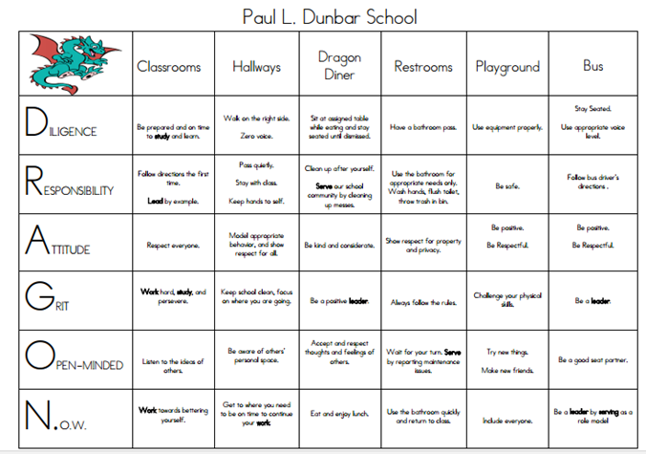
PBIS
PBIS

Slide 14
Live School-Download Parent App
LiveSchool is a program that reinforces positive behavior.
Students earn points for themselves and their house teams.
Students are able to track their behavior and celebrate successes by cashing in their points for incentives. DRAGON DEPOT
Parents are able to track student behaviors as well. Please ask homeroom teacher for login information.
HOUSE TEAMS

Slide 15
Electronic Gradebook
In alignment with our Strategic Priority: Engaged Community:
Teachers will be utilizing an electronic gradebook this year.
Teachers will update assignment grades in each quarter's 3rd, 6th, and final weeks (9th week) to ensure you are always informed of your scholar's progress.
Our goal is to enhance the collaboration between home and school and provide you with real-time access to your scholar's progress.

Slide 16

PowerSchool MyPowerHub
​MyPowerHub will allow you to access
Student Grades
Attendance
Class Schedules
Communicate with Teachers
Go to www.clevelandmetroschools/parent to create your account and the learn about the tools available on the hub.
About MyPowerHub: https://youtu.be/d9uNH9J18t4?si=9BuADURx5I1-6u0E
How to login: https://youtu.be/eNZs_AloU-c?si=5vR6nBWiNCCPrO2u
Once you have created your account you can download the PowerSchool app to your phone from the Apple App Store or the Google Play Store and use the district code GKCK to log in with your username and password.

Slide 17

Cell-Phone Free Learning Environments
Beginning this academic school year, all CMSD schools have created cell-phone-free environments to improve student learning and academic performance.
Our collection process will be when the students walk into the building. They will hand their phone to a staff member who will put the phone in a cell phone locker labeled with their names.
Thank you all for your support in this as this has been a smooth transition!
​

Slide 18
Purpose of Title IA - ESSA (Every Student Succeeds Act)
  To inform parents/caregivers of their rights and roles within their scholar's school building such as:
  Being included in decision making opportunities and committees regarding school improvement plans
  Participating in school-based parent organizations (SPO/PAC/PTO, etc.)
  Providing input on how Title IA Family Engagement funds are spent to support meaningful engagement activities which advance student achievement
  Ensuring that the school engages in two-way communication with parents to strengthen family/school partnerships
  Removing barriers to participation (time of day, childcare, translation services, accommodations for special needs, transportation, etc.)
​

Slide 19
Parent's Right to Know – Title IA ESSA
​Parents have the right to know about the teaching qualifications of their child's classroom teacher in a school receiving Title I funds. You can request this information from your principal.
Notification if your child is being taught for 4 or more weeks by a teacher who is not highly qualified.
Whether the teacher has met state qualification and licensing criteria for the grade levels and subject areas in which the teacher provides instruction
Whether the teacher is teaching under emergency or other provisional status through which State qualification or licensing criteria have been waived
Whether the teacher is teaching in the field of discipline of certification of the teacher
Whether your child is provided services by paraprofessionals and, if so, their qualifications

Slide 20
Our school receives Title IA Federal Funds to support
Instructional Aides​
Additional Teachers​
Technology for students​
Reading and Math programs ​
Family Engagement ​
  Our school receives $4,454.95 for family engagement programs and activities to support our school priorities​

Slide 21
Clubs, Programs, Extracurricular Activities
Cheerleading
Girl's Volleyball
Boys Basketball
Girl's Basketball
WAVE Team
Dancing Classrooms
Arts Impact
Cleveland Jazz Orchestra
Piano Cleveland

Slide 22


Reminder FATHER’S WALK
Thursday, September 19th Join us to celebrate fathers, father figures, and male role models.
*Bring your child to school *Take a photo!
*Get a Goodie Bag with Activities!
Kindergarten to 3rd grade- Thu 10/17/2024 3:00 PM
4th grade to 8th grade- Fri 10/18/2024 5:00pm-6:00pm

Slide 23
Schedule for rest of the evening
6:30-8:00: Meeting with Teachers
Be sure to check out our tables/clubs for information on:
RAFFLE! 2 DRAWINGS
Bake sale
Shirt Orders
Say Yes
6-8 grade Athletics Table
6-8 grade Good 2 Great –character development course
Piano Cleveland and Cleveland Jazz Orchestra Sign Up
​

Slide 24
Thank you.

